Slide 1

Adaptive Direction of Arrival Estimation of Signals using Log-Cosh Algorithm.
Name: Burri Sai Prathap Reddy
Roll Number: 2101EE21
Department of Electrical Engineering
Supervisor: Dr. Somanath Pradhan

Slide 2
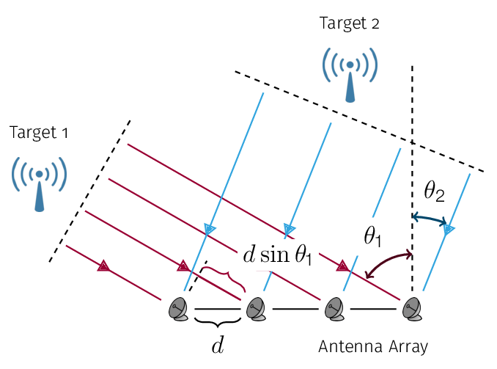
Introduction:
The direction of Arrival (DOA) refers to the technique or process of determining the direction from which a signal is received.
Signals captured by the array of sensors are passed through an adaptive filter.
Zeroth sensor is taken as reference, and the remaining array is called the Auxiliary array.
The signals received by the array contain added noise, which introduces a bias in the estimated filter weights, ultimately leading to suboptimal DOA estimation performance.
Antenna Array receiving signals from Targets
Image source: https://www.researchgate.net/publication/326854927_A_Review_of_Distributed_Algorithms_for_Principal_Component_Analysis

Slide 3

Introduction:
The signal received at the t^{th} snapshot can be expressed as:
$s(t) = z(t) + n(t),$ $z(t) = ∑ₘ xₘ(t )ṽ(θₘ),$
$N$is the number of sensors and M(<N) is the number of sources. $θₘ$ are the directions of the sources.
Antenna Array receiving signals from Targets
Image source: https://www.researchgate.net/publication/326854927_A_Review_of_Distributed_Algorithms_for_Principal_Component_Analysis

Slide 4
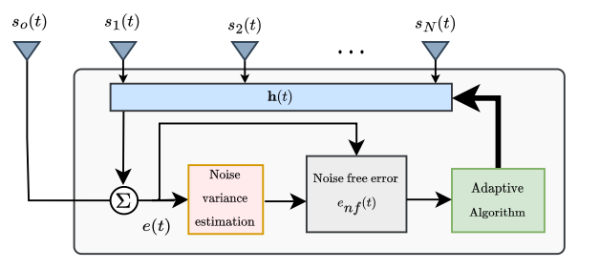


Methodology:
In DOA estimation, sensors, such as antennas or microphones, are arranged in an array.
To estimate the DOAs of the sources, the signal captured by the auxiliary array is first passed through a linear filter h(t) ∈ C^{(N−1)×1}.
Error is given by the equation:
The weight of the entire array is given by:
The error is minimized to obtain the optimal filter h.
Architecture
Image source: [1] from references

Slide 5

Methodology:
The condition w^{H}v(θ_{m}) = 0 is satisfied for all desired source directions.
As a result, the spatial spectrum is calculated as:
The denominator becomes very large in the source directions.
Therefore, peaks in the spectrum plotted using the above equation give the directions of the sources.
$$p\left(θ\right) = 1 / \left|wᴴv\left(θ\right)\right|,$$
Architecture
Image source: [1] from references

Slide 6
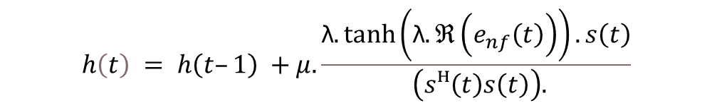
Methodology:
The proposed update rule is:
The noise-free error e_{nf}(t) is given by:
The noise variance iteratively calculated is given by:
β is the weighting factor for the variance estimation.
$$h\left(t\right) = h\left(t–1\right) +μ.\frac{\text{λ}.tanh\left(\text{λ}.ℜ\left(e_{nf}\left(t\right)\right)\right).s\left(t\right)}{ \left(sᴴ\left(t\right)s\left(t\right)\right).}$$
$$e_{nf}\left(t\right) = sign\left(e\left(t\right)\right) · max\left(e | \left(t\right) | | – \sqrt{q\left(t\right)}, 0\right),$$
[2]
$$q\left(t + 1\right) = βq\left(t\right) + \left(1 – β\right)\left|e_{nf}\left(t\right)\right|²,$$
Architecture
Image source: [1] from references

Slide 7
Methodology:
The adaptive algorithm will not be able to filter the uncorrelated components between the reference sensor and the auxiliary array.
The reference noise-free error converges to the noise variance of the auxiliary sensors. Because noise is uncorrelated.
This justifies the estimation of the noise using |e_{nf} (t)|².
Architecture
Image source: [1] from references

Slide 8
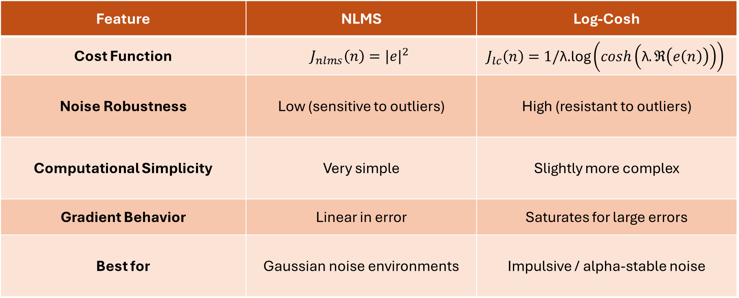
Cost Functions:
Feature | NLMS | Log-Cosh
Cost Function | $$J_{nlms}\left(n\right)={|e|}^{2}$$ | $$J_{lc}\left(n\right)=1/\text{λ}\text{.}\text{log}\left(cosh\left(\text{λ}.ℜ\left(e\left(n\right)\right)\right)\right)$$
Noise Robustness | Low (sensitive to outliers) | High (resistant to outliers)
Computational Simplicity | Very simple | Slightly more complex
Gradient Behavior | Linear in error | Saturates for large errors
Best for | Gaussian noise environments | Impulsive / alpha-stable noise

Slide 9
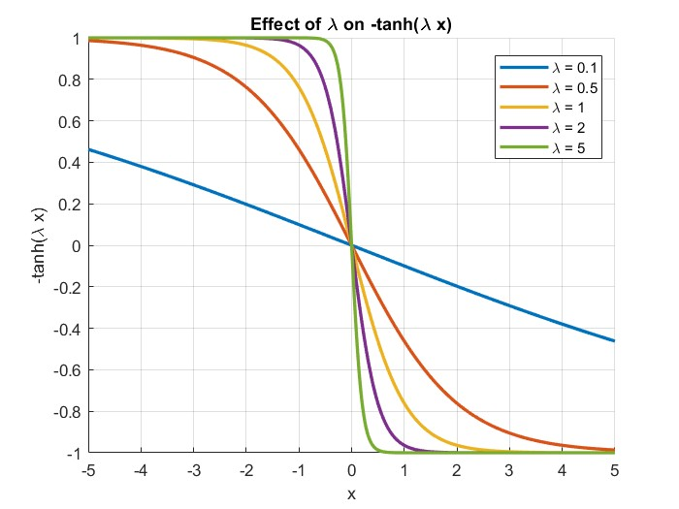
Gradient of Log Cosh:
The parameter λ (lambda) in the log-cosh cost function plays a critical role in controlling the sensitivity and robustness of the adaptive filter to errors.
λ Value | Behavior | Effect
Small λ | Log-cosh behaves like L2-norm (quadratic error) | Less robust, similar to NLMS; sensitive to large errors
Large λ | Log-cosh behaves like L1-norm (linear error) | More robust to outliers and impulsive noise
Optimal λ | Intermediate value | Balances between sensitivity to small errors and robustness to large ones

Slide 10
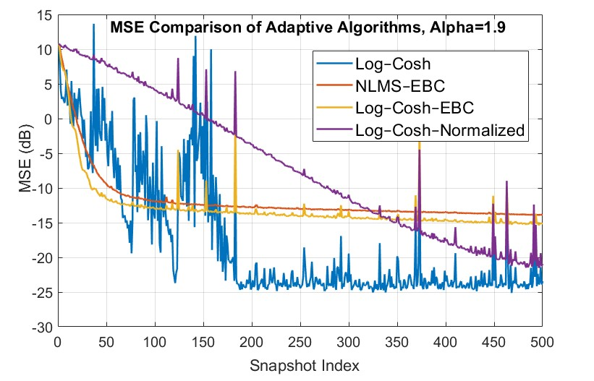
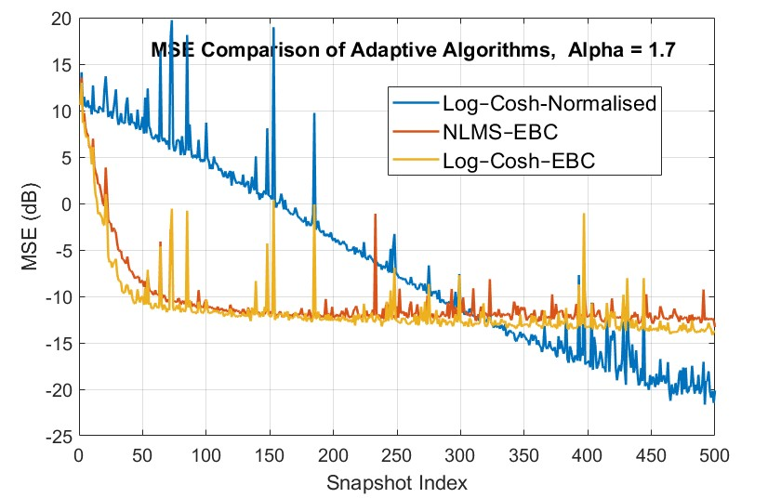
Plots:

Slide 11
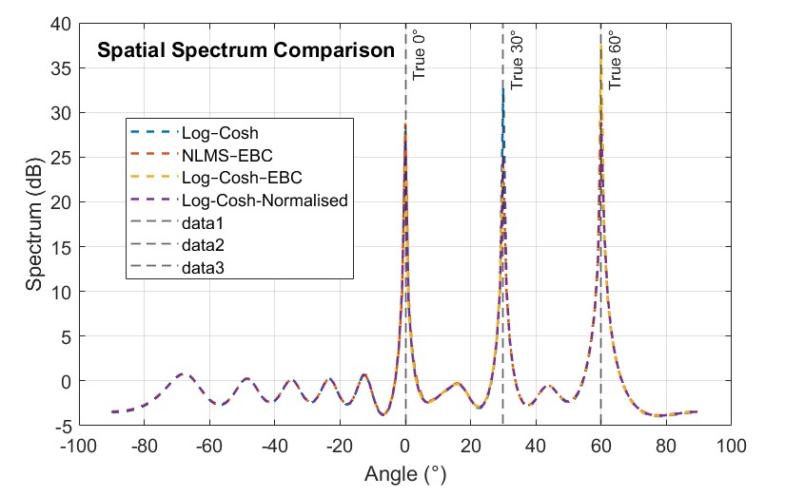
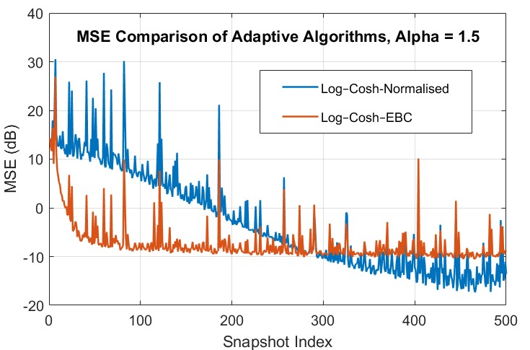
Plots:

Slide 12
Result & Conclusion:
EBC-NLMS performs well under mild impulsive noise but may diverge in high-noise settings due to its gradient being linearly dependent on the error.
Log-Cosh handles outliers (impulsive noise) better, but its robustness significantly improved when the error is normalized.
Lambda (λ) in Log-Cosh controls sensitivity: small λ for Gaussian noise, large λ for impulsive noise environments.
EBC-LogCosh, using noise-free error, achieves faster and more robust convergence, as seen in the error plots.

Slide 13
References:
[1] Kun Guo, Longxiang Guo, “Efficient DOA estimation based on variable least Lncosh algorithm under impulsive noise interferences”, Digital Signal Processing, Volume 122, 2022,103383, ISSN 1051- 2004.
[2] S. Joel, Shekhar Kumar Yadav, and Nithin V. George, ‘‘Enhanced Bias-Compensated NLMS for Adaptive DOA Estimation,’’ IEEE Trans. Instrum. Meas., vol. 8, NO. 5, MAY 2024.
[3] C. Liu and H. Zhao, “Efficient DOA estimation method using bias-compensated adaptive filtering,” IEEE Trans. Veh. Technol., vol. 69, no. 11, pp. 13087–13097,
Nov. 2020.
[4] P. Chen, Z. Chen, L. Liu, Y. Chen, and X. Wang, ‘‘SDOA-Net: An efficient deep- learning-based DOA estimation network for imperfect array,’’ IEEE Trans. Instrum. Meas., vol. 73, pp. 1–12, 2024.
[5] M. Pan et al., “Efficient joint DOA and TOA estimation for indoor positioning with 5G picocell base stations,” IEEE Trans. Instrum. Meas., vol. 71, pp. 1–19, 2022.

Slide 14
Thank You

